Slide 1
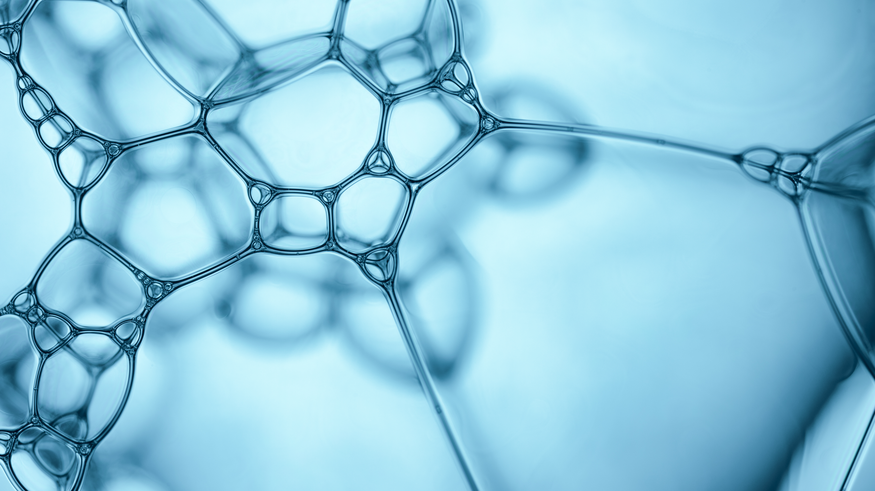
Predicting a Biological Response
By :
Zamzam Alsarayrah
Data Scientist
General Assembly

Slide 2
Problem statement :
As the chemical preparties of the different macules affect the biological response of these molecules which results in affecting the final product made by these molecules. Studying the biological activity of molecules using the test and trail can be costly in time and effort. Using the benefit of ML we are going to predict the biological activity response of different molecules based on their chemical preparties.
The data we got has the chemical preparties of different molecules beside the experimental data describing which a real biological response; the molecule was seen to elicit this response (1), or not (0).

Slide 3
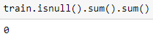
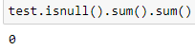
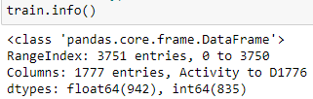
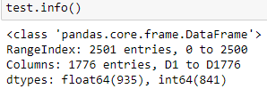
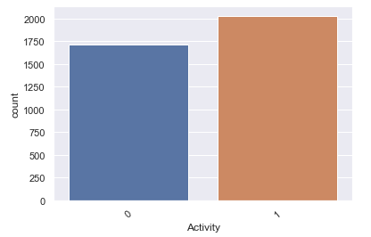
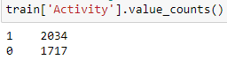
dataset / Exploratory Visualization
TRAINING DATASET: 3751, 1777 TESTING DATASET: 2501, 1776
Target :

Slide 4
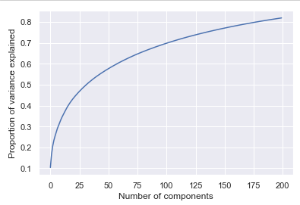
methods and models:
Principal Component Analysis (PCA)
Confusion matrix
Logistic Regression
Accuracy
Recall
Precision
Specificity
1- most important features relative to target.
Now we decreased the number 1777 to 153
2- all features.

Slide 5
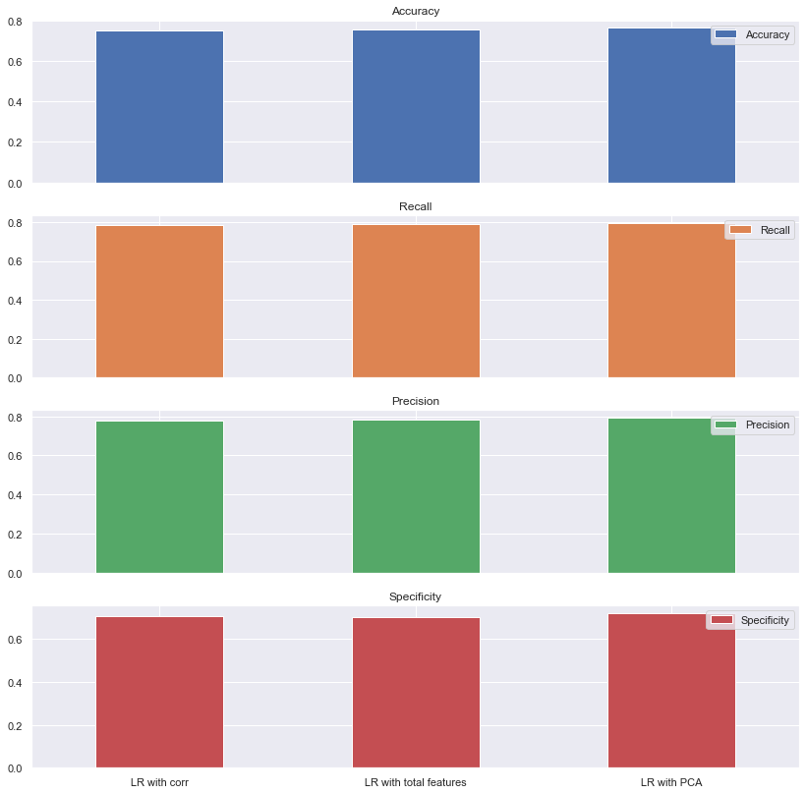
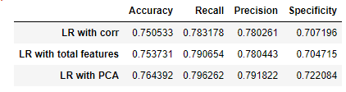
Confusion matrix

Slide 6
Conclusions :
As a conclusion from what we have applied to the data set:
1- When we applied the logistic regression to the whole features we had an overfit which was expected because the amount of data we have is very little compared to the number of features.
2- Using the heat map to reduce the number of features helped with reduce the overfit but still we have some amount of overfit.
3- PCA did help with the overfit but not as much as the heat map.
5- We need to get more train data to improve the model learning.
The overall all accuracy for all models wasn’t that good.

